Slide 1
SP3D Equipment Reference Data
Version 2009 SP1
October 2009
Notes:
SP3D Equipment Reference Data

Slide 2
What will be covered in this training?
Monday
Equipment Reference Data:
- Delivered Catalog
- Bulkload Utility
- Catalog Hierarchy
- Module Types
- Code List
- Equipment Hierarchy
- Custom Interface
- Equipment Assembly Class
Tuesday – Friday
Piping Reference Data:
- Delivered Catalog
- Piping material class data
- Piping Commodity Filter
- Verify consistency report
- Part Catalog
- Piping commodity material control data
- Valve operators
- Connection selection filters
- Piping Commodity generic data
- Additional spec rules
- Reference Data Changes
- Reportable commodities
- Cap screws
- Instrument/Specialty items
- Project Rules
© 2008. Intergraph Corporation. All Rights Reserved.
Notes:
SP3D Equipment Reference Data

Slide 3
SP3D Databases - Overview
Site Database:
Contains Project Management data such as the names of the databases, global work share locations and the permissions on the model and catalog databases.
Catalog Database:
Contains the design rules and the parts.
Model Database: Contains instances of the parts defined in the catalog.
Report Database : Collection of views on the model, site and catalog.
Schemas: Contains the data about the data. Describes all the business objects for the applications (pipe, fitting, beam, etc…) and their relationships.
Report Database set
Site Database set
Model Database
Catalog Database set
© 2008. Intergraph Corporation. All Rights Reserved.
Notes:
SP3D Equipment Reference Data

Slide 4
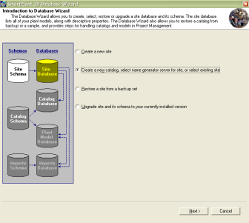

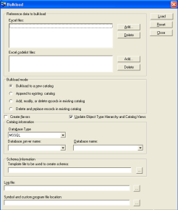

Catalog Database Creation
Database Wizard:
Quick restorable Catalog Database set that contains all Intergraph delivered sample data or restore your own CatalogUser.dat/CatalogUser.dmp
Bulkload Utility:
Creates new Catalog Database(s), and is used to maintain
existing Catalog Database(s).
© 2008. Intergraph Corporation. All Rights Reserved.
Notes:
SP3D Equipment Reference Data

Slide 5
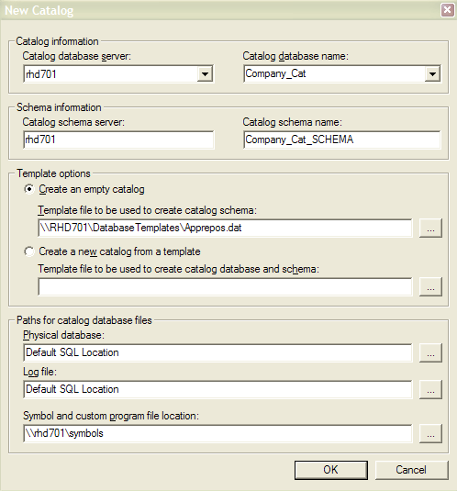
Catalog Database Creation
Project Management:
Allows you to create a new, empty catalog database and schema without bulkloading data.
An empty catalog is a catalog database that contains all of the tables, procedures, views, and so on, but does not contain any data, such as part data or specifications. You can also create a new catalog database and schema from a template with this command.
The Database > New > Catalog command uses the catalog database type for the active site to create the new catalog database
© 2008. Intergraph Corporation. All Rights Reserved.
Notes:
SP3D Equipment Reference Data

Slide 6
Catalogdb.Dat (SQL Backup Database)
Reference Data
  Parts (Equipment, Piping, HVAC, Cable tray, Structure, etc..)
  Rules (piping specifications, slabs specifications, etc…)
  Generic data tables
  Labels and report definition
  IFC Rules
  Naming rule definition
  and so on……
© 2008. Intergraph Corporation. All Rights Reserved.
Notes:
SP3D Equipment Reference Data

Slide 7
Using Excel Workbooks to Configure Reference Data:
  All non-graphical SmartPlant 3D reference data is stored in Microsoft Excel
  Workbooks. The default location for reference data workbooks is [Product
  Directory]\Catalog Data\BulkLoad\DataFiles.
  For example,
AllCodelist.xls
AllCommon.xls
ModuleTypes.xls
GenericNamingRules.xls
Reports.xls
IFCRule.xls
InsulationData.xls
Drawings.xls
BulkLoadIsoKeys.xls
SpaceMgmt.xls
Equipment.xls
EquipmentComponent.xls
DoorsEquipment.xls
Standard Nozzle Data.xls
Shapes.xls
© 2008. Intergraph Corporation. All Rights Reserved.
Notes:
SP3D Equipment Reference Data

Slide 8
Using Excel Workbooks to Configure Reference Data: (Cont.)
  Additional Reference Data is located in [Product Directory] \CatalogData\BulkLoad\AdditionalDataFiles\ and
  [Product Directory] \CatalogData\BulkLoad\SampleDataFiles
Equipment_SE.xls
Electrical Equipment.xls and Electrical Panelboard Sample Data.xls
Electrical Disconnect Switch Sample Data.xls
Horizontal Pump Symbol OH2 Sample Data.xls
Vertical Pump Symbol OH3 Sample Data.xls and HVAC Sample Equipments.xls
Spiral Stair Tank Equipment Comp Sample Data.xls
Spiral Stair Tank Equipment Sample Data.xls
Support Legs Component Sample Data.xls
Switch Gear Equipment Sample Data.xls
Switch Gear Sections Component Sample Data.xls
Sample Data for Valves.xls
© 2008. Intergraph Corporation. All Rights Reserved.
Notes:
SP3D Equipment Reference Data

Slide 9
Catalog Database Creation
Bulk Load Utility
AppRepos.Dat
New Catalog &
Catalog Schema
Reference Data
Excel workbooks
To add reference data to the catalog, you use the Bulkload utility to transfer Excel workbook data into the Catalog Database.
© 2008. Intergraph Corporation. All Rights Reserved.
Notes:
SP3D Equipment Reference Data
10
6

Slide 10
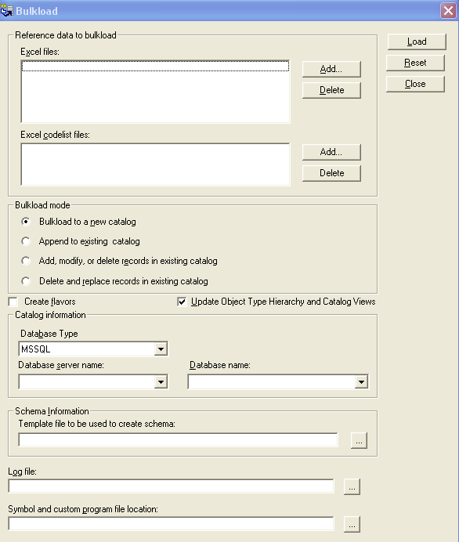
Bulkload Utility
The Bulkload Utility provides the primary mechanism to create/add/modify the catalog database. The data for creating the database is defined using Excel workbooks.
Bulkload Mode:
  Bulkload to a new catalog: is used for creating new catalog database
  Append: Add new data only
  Add/Modify/Delete: is used to update data
  Delete & Replace: is used to replace data in the database with the data currently in the workbooks
© 2008. Intergraph Corporation. All Rights Reserved.

Slide 11
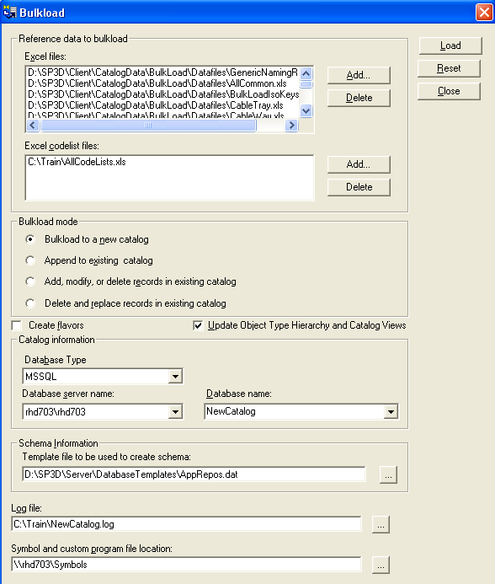
Bulkload Utility
Create New Catalog
- Bulkload to a new catalog
© 2008. Intergraph Corporation. All Rights Reserved.

Slide 12
Lab 1 - Creating a new Catalog Database
© 2008. Intergraph Corporation. All Rights Reserved.

Slide 13
CatalogDB.Dat/CatalogDB.dmp
Step 1
Company Excel sheets
Step 2
Bulk Load Utility
Step 3
SQL Server Management Studio
Or SP3DOracleDBToolsWizard.exe
Catalog &
Catalog Schema
Backup Catalog
Backup Catalog Schema
UserCatalogdb.dat or UserCatalogdb.dmp
© 2008. Intergraph Corporation. All Rights Reserved.
Notes:
SP3D Equipment Reference Data
10
6

Slide 14
Using Excel Workbooks to Configure
Catalog Data
  Common Sheets
  Revision History*
  Legend*
  Index*
  CatalogRoot
  ClassNodeType
  R-ClassNodeDescribes
  R-Hierarchy
  Custom Interfaces
  GUIDs
  * The Bulkload utility does not process these sheets, so you can enter any comments and information on them.
© 2008. Intergraph Corporation. All Rights Reserved.
Notes:
SP3D Equipment Reference Data

Slide 15
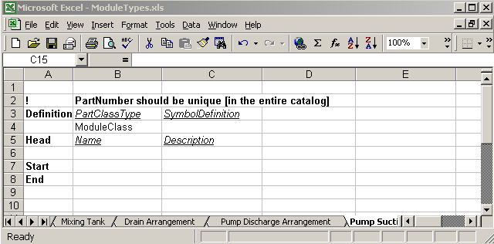
Using Excel Workbooks to Configure
Catalog Data
  Bulkload Excel Format
  The “Head”, “Start” and “End” are always required in the first column. One can have as many empty rows as he/she wants to, anywhere in the sheets. Comments can be put by putting “!” in the first cell of the row in which the comment needs to be put.
  Letter bulkload mode A,M,D
© 2008. Intergraph Corporation. All Rights Reserved.
Notes:
SP3D Equipment Reference Data

Slide 16
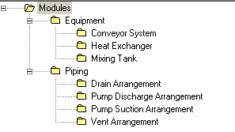
Common Sheets
Organizational Hierarchy Sheets
Hierarchy sheets provide the means to manage which items and where items are displayed in the Catalog Task.
CatalogRoot
ClassNodeType
R-Hierachy (parent-child relations)
R-ClassNodeDescribes
Object Class
© 2008. Intergraph Corporation. All Rights Reserved.
Notes:
SP3D Equipment Reference Data
10
4

Slide 17
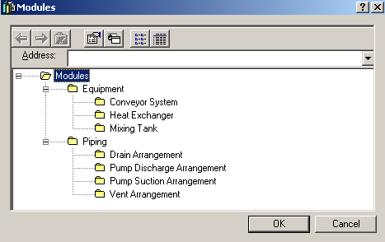
Module Types
© 2008. Intergraph Corporation. All Rights Reserved.
Notes:
SP3D Equipment Reference Data

Slide 18
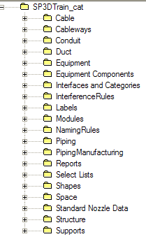
Using Excel Workbooks to Configure
Catalog Data
  Catalog Hierarchy
  CatalogRoot
© 2008. Intergraph Corporation. All Rights Reserved.
Notes:
SP3D Equipment Reference Data

Slide 19
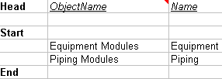
Using Excel Workbooks to Configure
Catalog Data
  ClassNodeType
    allows you to create a classification folders in the Catalog hierarchy.
    Object Name column: folder object name
    Name column: folder name in the GUI.
© 2008. Intergraph Corporation. All Rights Reserved.
Notes:
SP3D Equipment Reference Data

Slide 20
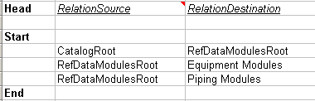

Using Excel Workbooks to Configure
Catalog Data
  R-Hierarchy
    contains the parent-child relationships between folders in the Catalog Hierarchy.
    RelationSource column: specifies the parent object names.
    RelationDestination column: specifies the children object names.
© 2008. Intergraph Corporation. All Rights Reserved.
Notes:
SP3D Equipment Reference Data

Slide 21
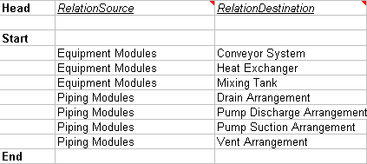
Using Excel Workbooks to Configure
Catalog Data
  R-ClassNodeDescribes
    Defines the parent-child relationships between the classification folders and the part classes.
    RelationSource column: specifies the classification folder.
    RelationDestination column: specifies the object classes associated with the classification folder.
© 2008. Intergraph Corporation. All Rights Reserved.
Notes:
SP3D Equipment Reference Data

Slide 22
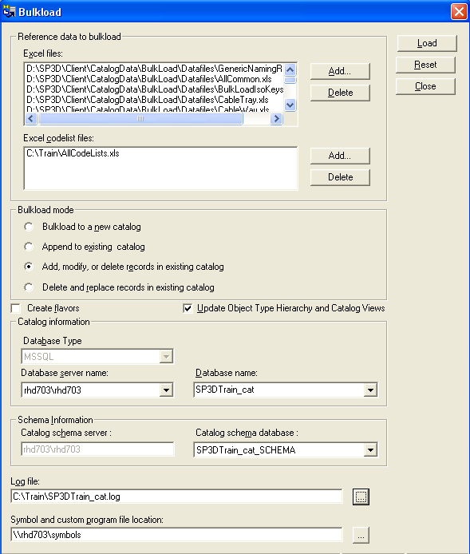
Bulkload Utility
Mode:
Append
Add/Modify/Delete
Create Flavors
Update Object Type Hierarchy
and Catalog Views
Flavors apply to
Solid Edge parts only.
You should close all Excel workbooks
before starting the bulkload. Do not
open Excel during the bulkload.
© 2008. Intergraph Corporation. All Rights Reserved.

Slide 23
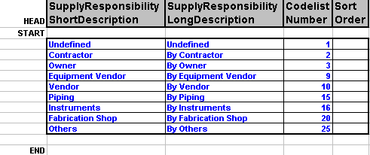
Code List
Codelists – Key or common terms that have been grouped and enumerated
Key Columns:
  Short/Long Description
  Codelist Number
  Sort Order (Not used in v2009)
© 2008. Intergraph Corporation. All Rights Reserved.
Notes:
SP3D Equipment Reference Data
Appendix A

Slide 24
Lab 2 - Catalog Hierarchy
© 2008. Intergraph Corporation. All Rights Reserved.

Slide 25
Reference Data Management
Step 1
Bulk Load Utility
Step 2
View Generator Utility or Synchronize Model with Catalog Command
Step 3
Re-generate the reports database command
Catalog &
Catalog Schema
Model
Report &
Report Schema
Bulkload utility will update the views in the catalog database
View Generator Utility will update the views in the model database
Synchronize model with catalog command will update the views and re-compute all the part occurrences in the model
Re-generate the report database command will re-generate the views in the report database
© 2008. Intergraph Corporation. All Rights Reserved.
Notes:
SP3D Equipment Reference Data
10
6

Slide 26
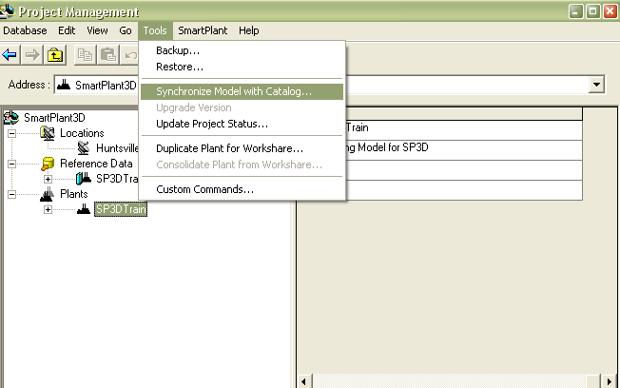
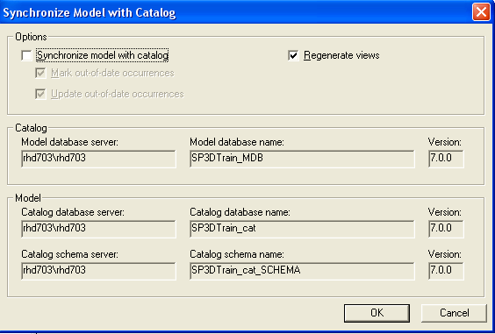
Reference Data Management
© 2008. Intergraph Corporation. All Rights Reserved.
Notes:
SP3D Equipment Reference Data
10
6

Slide 27
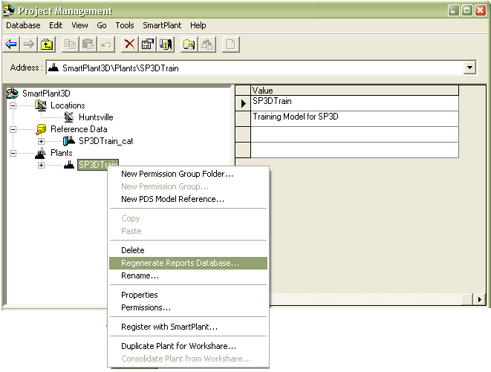
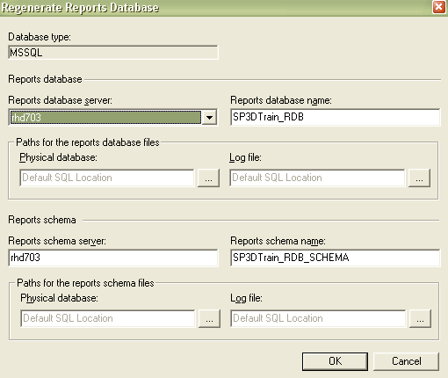
Reference Data Management
© 2008. Intergraph Corporation. All Rights Reserved.
Notes:
SP3D Equipment Reference Data
10
6

Slide 28

Common Sheets
Using Excel Workbooks to Configure
Catalog Data
CatalogRoot
ClassNodeType
R-Hierarchy (parent-child relations)
Equipment Assembly Class
A Equipment Assembly Class is a grouping of items that share similar characteristics
© 2008. Intergraph Corporation. All Rights Reserved.
Notes:
SP3D Equipment Reference Data
10
4

Slide 29
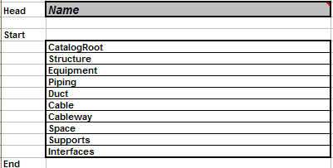
Using Excel Workbooks to Configure
Catalog Data
  Catalog Hierarchy
  CatalogRoot
© 2008. Intergraph Corporation. All Rights Reserved.
Notes:
SP3D Equipment Reference Data

Slide 30

Using Excel Workbooks to Configure
Catalog Data
  ClassNodeType
    allows you to create a classification folders in the Catalog hierarchy.
    Object Name column: folder object name
    Name column: folder name in the GUI.
© 2008. Intergraph Corporation. All Rights Reserved.
Notes:
SP3D Equipment Reference Data

Slide 31
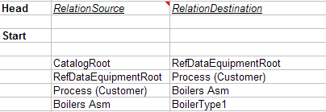
Using Excel Workbooks to Configure
Catalog Data
  R-Hierarchy
    contains the parent-child relationships between folders in the Catalog Hierarchy.
    RelationSource column: specifies the parent object names.
    RelationDestination column: specifies the children object names.
© 2008. Intergraph Corporation. All Rights Reserved.
Notes:
SP3D Equipment Reference Data

Slide 32
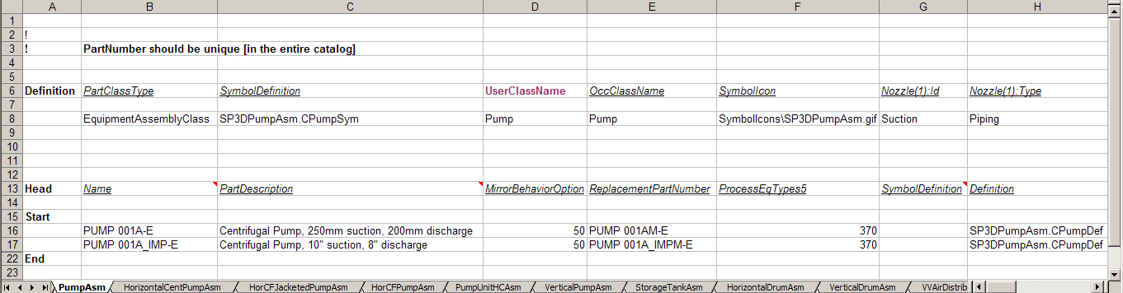
Using Excel Workbooks to Configure
Catalog Data- Part Class Sheet
Equipment Assembly Class is a grouping of smart items that share similar characteristics
© 2008. Intergraph Corporation. All Rights Reserved.
Notes:
SP3D Equipment Reference Data

Slide 33
Class Definition
  Part Class Type: Type of Class (Example: EquipmentAssemblyClass)
  Symbol Definition: Default Geometric definition for all the parts under this class
  SymbolIcon: Specifies a graphic file for the preview dialog of the part class
  UserClassName: Sets the user name for the part class that appears in the Catalog Browser.
OccClassName: Sets the occurrence name for the part class that appears in the filter dialog box (Business Object Classification)
  Port ID’s: Defines the port ID
  Port Type: Defines the port Type
  Occurrence Attributes: are properties that you can change for a specific part in the model.
© 2008. Intergraph Corporation. All Rights Reserved.

Slide 34
Parts
Part section consists of the following:
Common Properties
Custom Assembly Definition
Custom Properties
Port Data
© 2008. Intergraph Corporation. All Rights Reserved.

Slide 35




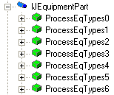
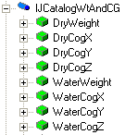
Equipment Reference Data Model
Common Properties
Custom Properties
The Custom Interfaces sheet defines the customized user interfaces and attributes (properties) for the part classes.
© 2008. Intergraph Corporation. All Rights Reserved.
Notes:
SP3D Equipment Reference Data
10
6

Slide 36
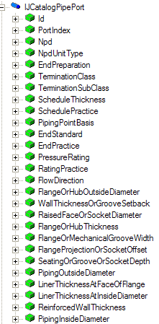
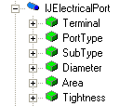
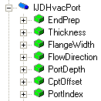
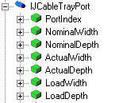
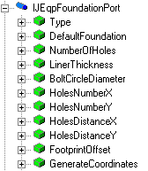
Equipment Reference Data Model
Port Properties
© 2008. Intergraph Corporation. All Rights Reserved.
Notes:
SP3D Equipment Reference Data
10
6

Slide 37
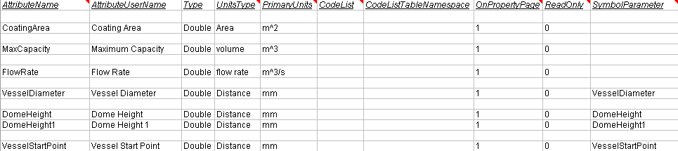
Custom Interfaces Sheet
The Custom Interfaces sheet defines the customized user interfaces and attributes (properties) for the part classes in the workbook.
An interface is a collection of attributes.
Provides a mechanism to map the attributes of the part class to the symbol inputs.
When you bulk load the workbook, the software looks at each user attribute on the class sheets and uses the Custom Interfaces sheet to decode the information.
© 2008. Intergraph Corporation. All Rights Reserved.

Slide 38

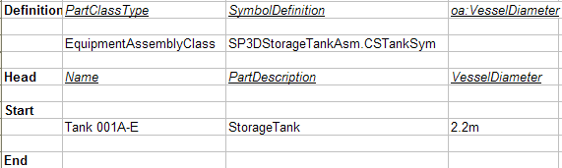
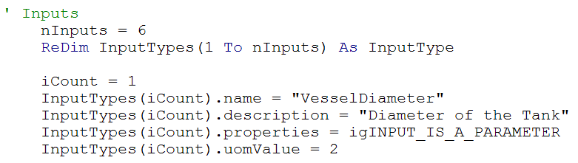
Using Excel Workbooks to Configure
Catalog Data
© 2008. Intergraph Corporation. All Rights Reserved.
Notes:
SP3D Equipment Reference Data

Slide 39
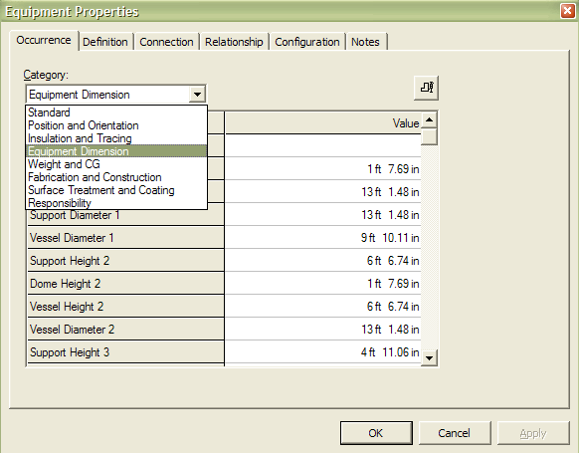
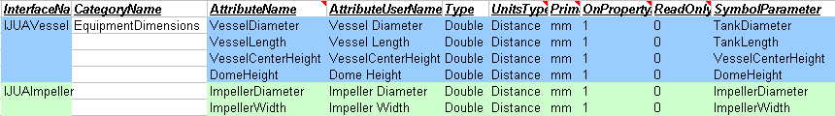
Custom Interfaces Sheet
Category Name
Category Name (CodeList)
Attribute Name
Attribute User Name
Attribute User Name
© 2008. Intergraph Corporation. All Rights Reserved.
Notes:
SP3D Equipment Reference Data

Slide 40

Custom Interfaces Sheet
  An attribute with the same name can exist on more than one interface. On a part class
  sheet, you can scope the user attributes based on their interfaces and symbol
  parameters. The scoping syntax is
  Interface::UserAttribute<Symbol Parameter>.
© 2008. Intergraph Corporation. All Rights Reserved.
Notes:
SP3D Equipment Reference Data

Slide 41
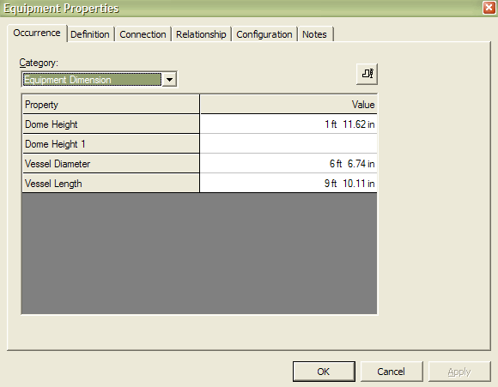
Custom Interfaces Sheet
  When an object uses a single attribute from an interface, the object also inherits all the attributes for that interface regardless of whether the object uses the other attributes.
© 2008. Intergraph Corporation. All Rights Reserved.
Notes:
SP3D Equipment Reference Data

Slide 42
Lab 3 - Equipment Catalog Hierarchy
Lab 4 – Working with the Custom Interface Sheet
© 2008. Intergraph Corporation. All Rights Reserved.

Slide 43
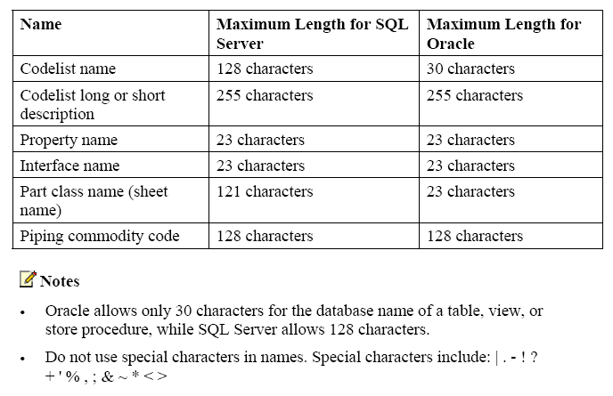
Using Excel Workbooks to Configure
Catalog Data
  Name Limitations
© 2008. Intergraph Corporation. All Rights Reserved.
Notes:
SP3D Equipment Reference Data
Appendix C

